Slide 1
OneBusAway:
Improving the Usability of Public Transit
Brian Ferris, Kari Watkins, and Alan Borning University of Washington

Slide 2
Outline
Motivations
What is OneBusAway?
Research Questions
  Assessing behavior change
  Real-time travel assistance
  Value-Sensitive Design (including tools for blind and deaf-blind users, other stakeholder groups)
Looking forward

Slide 3
Motivations
The goal of OneBusAway is to help provide a better experience for riders, and to encourage more people to use public transit.
Focus on:
  Innovative technological solutions
  Usability
  Free as in speech and beer
Personal: I don’t own a car and ride the bus everywhere

Slide 4
What is OneBusAway?

Slide 5
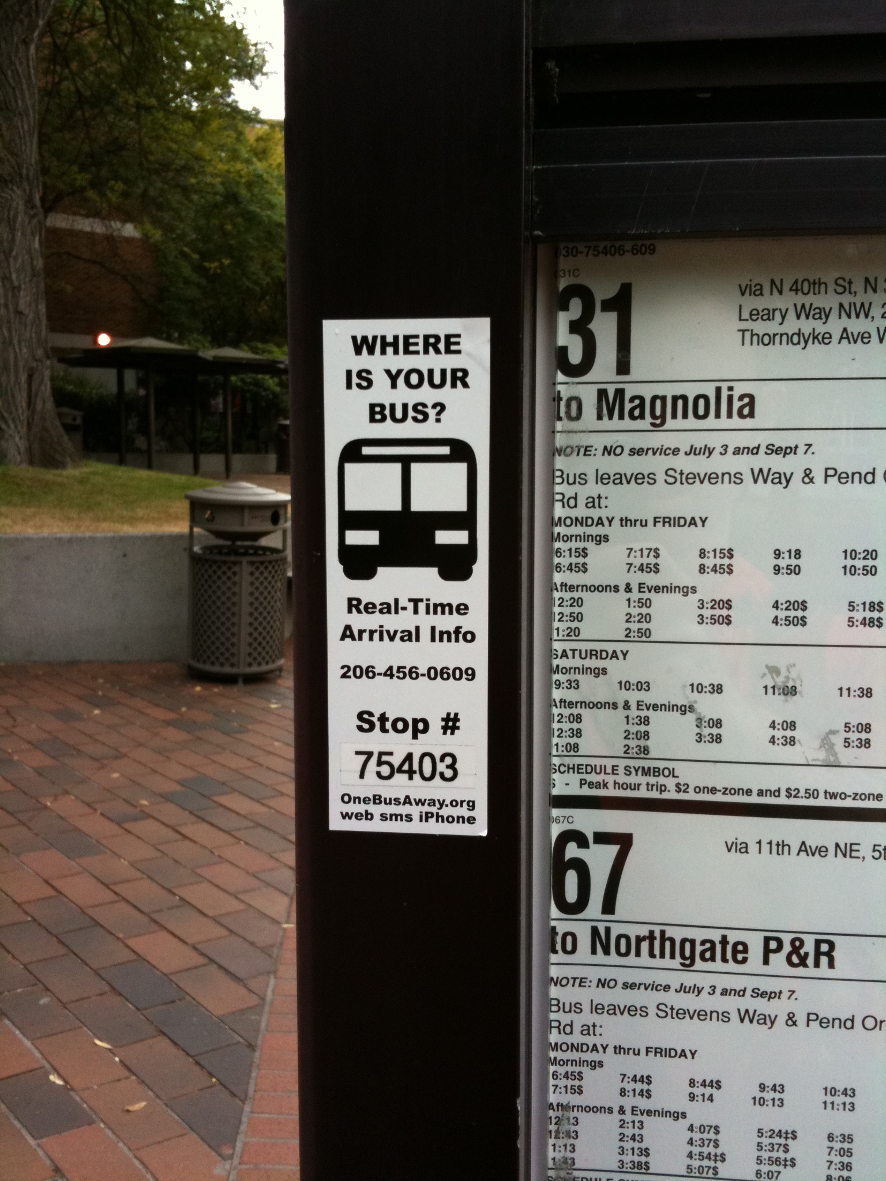
OneBusAway – Real-Time Arrivals
Better user interface to King County Metro real-time arrival info (Seattle & surrounding cities)
Supports phone, web, SMS, mobile web, iPhone, other mobiles
Born out of frustration with existing tools

Slide 6
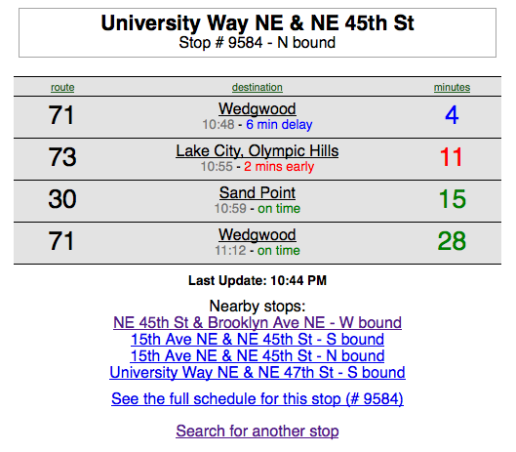
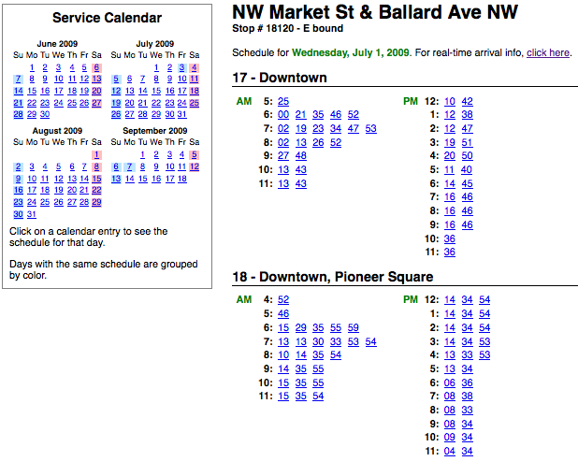
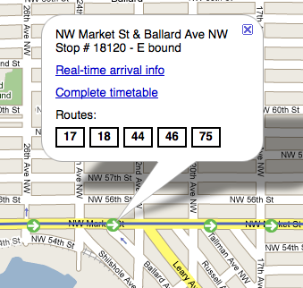
Basic Features
Real-time arrivals, schedule data, map interface

Slide 7
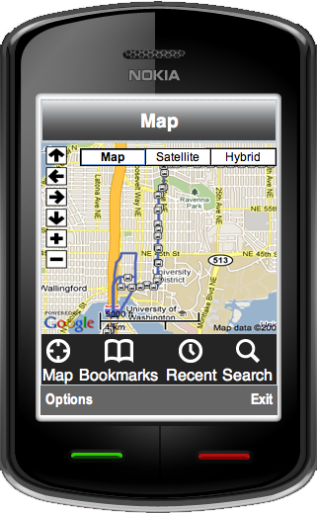
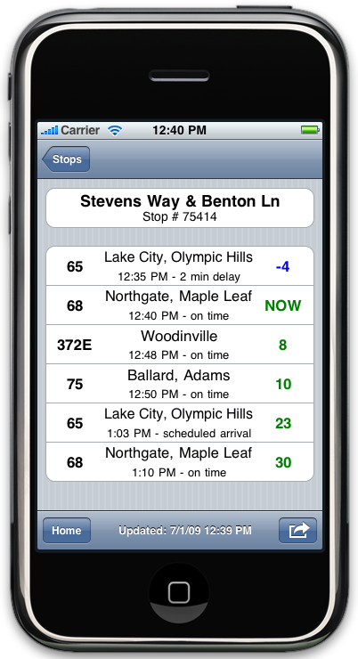
Mobile Tools
Native mobile apps combine real-time arrival info with location-aware features
Nokia, iPhone, Palm Pre, Android…
Even more as mobile web app

Slide 8
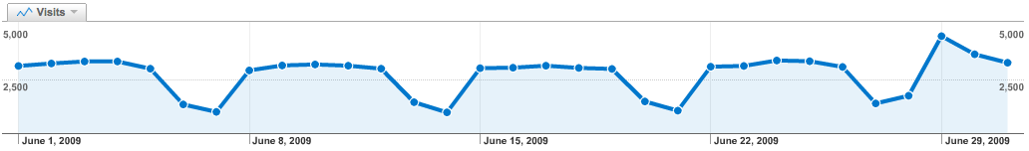
Usage Statistics
On a daily basis:
  Web: 4k visits
  iPhone: 4.5k
  Phone: 2k
  SMS: 0.5k
More traffic than KCM’s own tracker pages

Slide 9
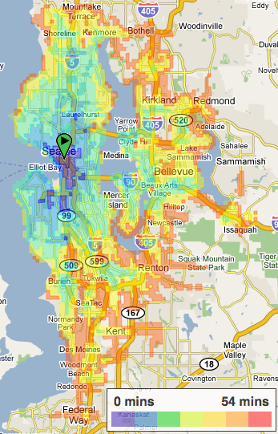
OneBusAway Explore Tool
Answer the question “What can I get to that’s just one bus ride away?”
Mashup transit-shed coverage network and Yelp local reviews database

Slide 10
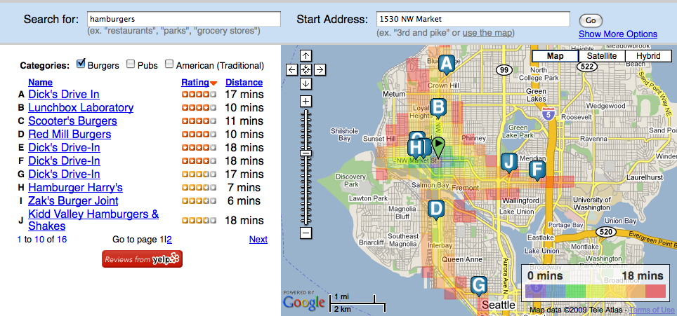
OneBusAway Explore Tool
Search for “hamburgers” within 20 minutes of my house using public transit

Slide 11
Goals for Deployment
Build open-source transit traveler information systems
  Use transit data in standard formats:
    GTFS, TCIP, etc
  Provide agencies with these tools for as close to free as possible
Let’s build great tools once and share them with agencies big and small

Slide 12
Research & OneBusAway

Slide 13
Research Question:
Is OneBusAway changing user perceptions and behavior with respect to public transit?

Slide 14
Assessing Behavior Change
August 2009 survey of 488 OneBusAway users
Specific questions about OneBusAway:
  “Now that you’ve been using OneBusAway, how has __BLANK__ changed?”
  Satisfaction with transit
  Usage of transit, Wait time
  Safety, Walking
Caveats: self-report, no control group

Slide 15
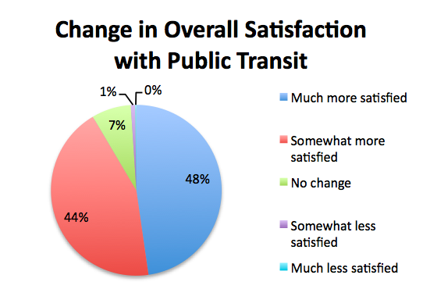
Change in Satisfaction
“I no longer sit with pitted stomach wondering where is the bus. It's less stressful simply knowing it's nine minutes away, or whatever the case.”

Slide 16
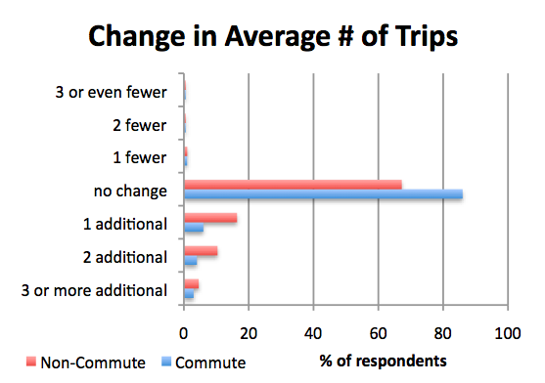
Change in Usage
“While my work usage was pretty much on a fixed schedule, OneBusAway has made impromptu trips much more convenient.”

Slide 17
Personal Safety
18% of respondents reported feeling somewhat safer and 3% reported feeling much safer.
Safety was correlated with gender
“Having the ability to know when my bus will arrive helps me decide whether or not to stay at a bus stop that I may feel a little sketchy about or move on to a different one. Or even, stay inside of a building until the bus does arrive.”

Slide 18
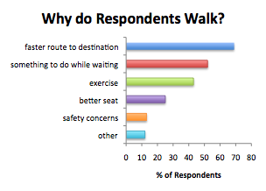
Change in Walking Behavior
78% of respondents said they were more likely to talk to another stop ⇒ positive health impacts
“Before OneBusAway, I played what I like to call Metro
Roulette: start walking to the next stop for exercise, and hope my bus
didn't pass me by. Now, though I miss out on the adrenaline rush elicited
by Metro Roulette, I can make an informed decision about whether or not to
walk to the next stop…”

Slide 19
Research Question
Can we build a mobile tool that knows in real-time which bus you are on and where you are going?

Slide 20
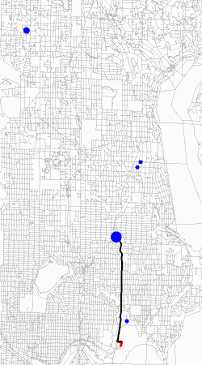
Intelligent Mobile Tools
Intelligent Travel Assistant
Automatically learns travel patterns
Detects errors by the user and provides directions when things go wrong

Slide 21
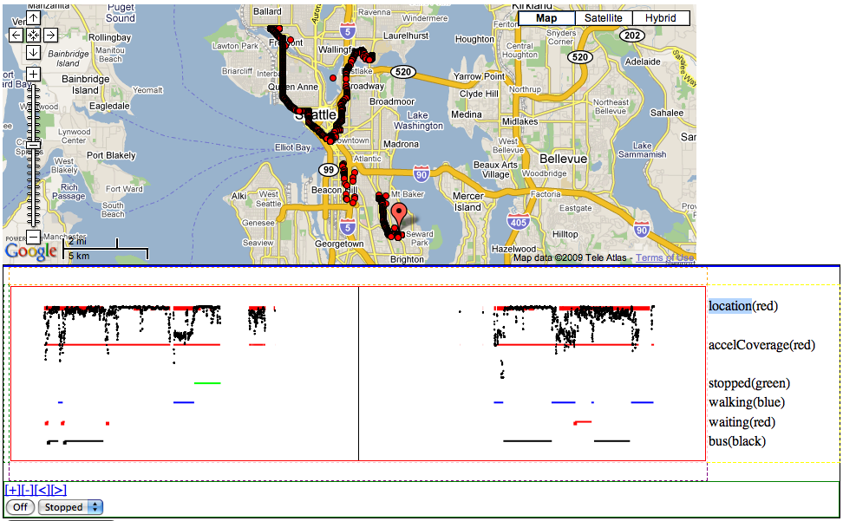
Data Collection

Slide 22
Initial Goals
Can we reliably predict:
  Your current travel mode in real-time?
    YES: With 90% accuracy using accelerometer + GPS + simple boosted classifier
  Which transit vehicle you are currently on?
    Working on it… initial results good.
  Your final destination?
  When something has gone wrong?

Slide 23
Long Term
Once we have a good travel activity logger
  Build models of long-term travel patterns
Use patterns:
  To detect exceptions, errors
  For better travel choice modeling
  For everyone: better mobile trip planner

Slide 24
Research Question
What is the best use of our limited resources to meet the needs of the community?

Slide 25
Who do we build for?
New smart phones are sexy…
  But not everyone has one
  Should we assume even a basic cell phone?
Are we putting technology ahead of the problem?
How do we trade off building high-end tools
for choice riders vs. building tools for those who must use transit?

Slide 26
Value Sensitive Design Study
Class project at UW (Borning, Friedman)
VSD: Design of tech focusing on human values in a principled way
For OneBusAway:
  Systematic stakeholder analysis (both direct & indirect)
  Value analysis for different stakeholders
  Study of existing tools and potential future tools
    What do we build next? How can we maximize our impact?

Slide 27
Research Question
In our preliminary stakeholder analysis, blind and deaf-blind users are one significant group, because they often depend on transit for basic mobility (ethical issue) and because they may not be well-served by the existing applications.
How can we improve the usability and safety of public transit for blind and deaf-blind users?

Slide 28
Accessible Mobile Tools
Working with blind and deaf-blind user groups
Develop usable tools for transit
Focus on powerful mobiles phones:
  Location-aware
  Text-to-speech

Slide 29
Accessible Mobile Tools
Exploring interesting interface modalities for blind, deaf-blind:
  Simulating braille on a touch-screen phone with vibrations
  Touch-screen + audio only interface

Slide 30
Looking forward

Slide 31
Looking forward
Open-source transit traveler tools:
  Smart mobile tools for real-time travel assistance
  Accessible mobile tools for blind & deaf-blind users
  Longitudinal study of transit usage patterns
OneBusAway:
  Keep building innovative transit tools
  Make public transit easy, convenient, and safe

Slide 32
Thanks!
This work has been funded by Nokia Research and the National Science Foundation.
Questions?

